Slide 1
Daniel Kahneman - A precursor to Behavioral Economics
20HS20013 - Ayush Aware
20HS20011 - Aryan Gupta
18EC10053 - Saswata Banerjee
20HS20050 - Shagun Katariya

Slide 2
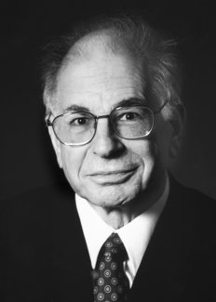
Who is Daniel Kahneman?
Daniel Kahneman is an Israeli psychologist and economist primarily known for his work on psychology of judgement and human decision-making. He won the Nobel Prize in Economics in 2002 due to his work on Prospect Theory. His empirical findings challenge the assumption of human rationality prevailing in modern economic theory. His work was regarded as an inspiration by Richard Thaler, the father of Behavioral Economics, to be an inspiration, and thus a precursor to modern behavioral economics.
He is currently Professor Emeritus of Psychology and Public Affairs at Princeton University’s Princeton School of Public and International Affairs.
Kahneman never regarded himself as an economist, but his contribution to modern heterodox economic theory is unquestionably important.

Slide 3
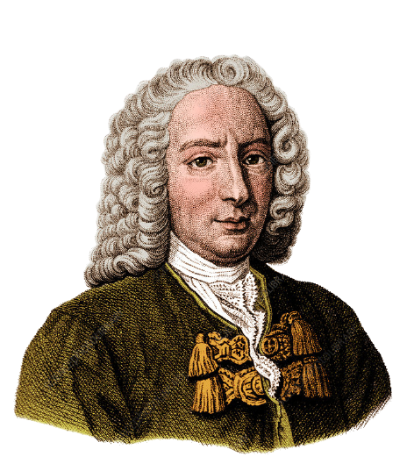
Precursor to Kahneman’s Work: Utility Theory
Utility theory was proposed by Swiss mathematician Daniel Bernoulli in 1738.
It postulated in economics to explain behavior of individuals based on the premise people can consistently order rank their choices depending upon their preferences.
It explains why people are most risk averse when it comes to make decision that could result in loss especially in situation such as gambling.
It assumes individuals will choose the outcome which gives maximum utility given the probability of outcomes.
Daniel Bernoulli
(1700-1782)

Slide 4
Assumptions
Completeness: Individuals can rank order all possible bundles. Rank ordering implies that the theory assumes that, no matter how many combinations of consumption bundles are placed in front of the individual, each individual can always rank them in some order based on preferences.mathematically this property is called completeness.
More-is-better: Assume if an individual prefers consumption of choice A of goods to choice B. Then if he is offered another choice, which contains more of everything in choice A. Then more-is-better assumption says that individuals prefer new choice to choice A , which in turn is preferred to B , but also choice A itself.
Mix-is-better: Suppose an individual is indifferent between two choices. Thus, either choice by itself is not preferred over the other. The “mix-is-better” assumption about preferences says that a mix of the two will be preferred to both stand-alone choices.
Rationality: This is the most important and controversial assumption that underlies all of utility theory. Under this assumption , individuals’ preferences avoid any kind of circularity; that is, if choice A is preferred to B, and B is preferred C, then A is also preferred to C. Under no circumstances will the individual prefer C to A.

Slide 5
Why Utility theory fails ?
Utility theory basically suggests that people make decisions based on a perfectly rational evaluation of all the potential gains and losses that are associated with that decision.
For example - the utility of getting an extra $500 when your wealth is $1 million is the difference between the utility of $500 and the utility of $1 million. And if you own the larger amount,the disutility of losing $500 is again the difference between the utilities of the two states of wealth.
In this theory, the utilities of gains and losses are allowed to differ only in their sign (+ or –). There is no way to represent the fact that the disutility of losing $500 could be greater than the utility of winning the same amount—though of course it is.
Possible differences between gains and losses were neither expected nor studied in this theory. The distinction between gains and losses was assumed not to matter, so there was no point in examining it.
Losses and gains are valued differently, and thus individuals make decisions based on perceived gains instead of perceived losses.This utility theory does not take account this fact, so new Prospect theory was developed which take account this fact.

Slide 6
Cognitive Bias
According to Daniel Kahneman, cognitive bias is a systematic error in thinking that impacts one’s choices and judgments. Our brain absorbs lot of information during a day. Some of this information we consciously think about. But as the conscious part of the brain can only be focused one thing at a time, our brain is looking for shortcuts to helps us make decisions. These shortcuts are called heuristics . These heuristics often fail to produce a correct judgment, and the result is cognitive biases.
Some signs that you might be influenced by some type of cognitive bias include: only paying attention to news stories that confirm your opinions (confirmation bias), blaming outside factors when things don’t go your way (self-serving bias). Attributing other people’s success to luck, but taking personal credit for your own accomplishments.

Slide 7
Types of Cognitive Bias
Priming Bias:
Tendency to be influenced by the first presentation of an issue to create our preconceived idea of it, which we then can adjust with later information.
For example, the word NURSE is recognized more quickly following the word DOCTOR than following the word BREAD.
Framing Bias:
The framing effect is a cognitive bias where people decide on options based on whether the options are presented with positive or negative connotations; e.g. as a loss or as a gain. People tend to risk when a positive frame is presented but seek risks when a negative frame is presented.
For example, take two yogurt pots. One says “ 10 percent fat” and another says “90 percent fat free”.The framing effect lead to us picking the second option, as it seems like the second is healthier option.

Slide 8
Types of cognitive Bias
Anchoring Bias:
The incapability of people to make appropriate adjustments from a starting point to cause into a final answer, it can lead people to make sub-optimal decisions. Anchoring affects decision making in negotiations, medical diagnoses, and including judicial sentencing.
For example, an individual may be more likely to purchase a car if it is placed alongside a more expensive model (the anchor). Prices discussed in negotiations that are lower than the anchor may seem reasonable, perhaps even cheap to the buyer, even if said prices are still relatively higher than the actual market value of the car.
Overconfidence:
The most damaging of these is overconfidence: the kind of optimism that leads governments to believe that wars are quickly winnable and capital projects will come in on budget despite statistics predicting exactly the opposite. It is the bias he says he would most like to eliminate if he had a magic wand.
For example, in a spelling task, subjects were correct about 80% of the time, whereas they claimed to be 100% certain.^{[5]} Put another way, the error rate was 20% when subjects expected it to be 0%. In a series where subjects made true-or-false responses to general knowledge statements, they were overconfident at all levels. When they were 100% certain of their answer to a question, they were wrong 20% of the time.

Slide 9
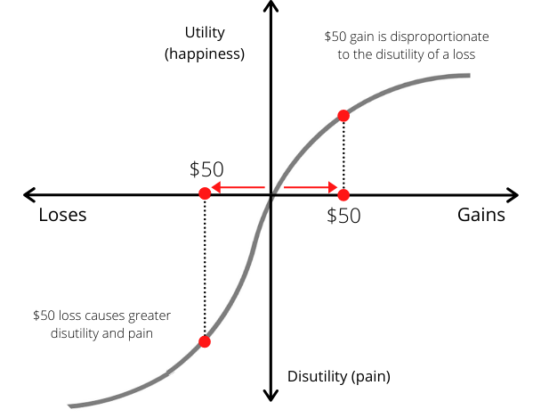
Prospect Theory
It is part of Behavioral Economics developed in 1992 and also termed as loss-aversion theory
When faced with potential gains, individuals are risk- averse. However,when faced with potential loss, individuals become risk-seeking.
Individuals dislike losing more than like gaining.
Expected utility relative to reference point rather than absolute outcome.

Slide 10
Assumptions
Irrationality like human emotions has been introduced instead of rationality.
People should have options between some fixed outcome and some probable outcome.
For the isolation effect to work different routes should be present for the same outcome.
Utility with respect to reference point but not lump sum.

Slide 11
Applications
In economics the behaviors like disposition effect, reflection effect can be explained by using prospect theory.
The situations like equity premium puzzle, status quo bias, intertemporal consumption, which are inconsistent with rationality can be explained
In politics, politicians phrase an economic policy as ensuring 78% employment rather than 22% unemployment.
Rose McDermott applied prospect theory to various American foreign policies.

Slide 12
Endowment Effect
In psychology and behavioral economics, the endowment effect (also known as divestiture aversion and related to the mere ownership effect in social psychology) is the finding that people are more likely to retain an object they own than acquire that same object when they do not own it.
This is typically illustrated in two ways. In a valuation paradigm, people's maximum willingness to pay (WTP) to acquire an object is typically lower than the value corresponding to their minimum willingness to accept (WTA) to give up that same object when they own it—even when there is no cause for attachment, or even if the item was only obtained minutes ago. In an exchange paradigm, people given a good are reluctant to trade it for another good of similar value.
One of the most famous examples of the endowment effect in the literature is from a study by Daniel Kahneman, Jack Knetsch & Richard Thaler, in which participants were given a mug and then offered the chance to sell it or trade it for an equally valued alternative (pens). They found that the amount participants required as compensation for the mug once their ownership of the mug had been established (WTA) was approximately twice as high as the amount they were willing to pay to acquire the mug (WTP).

Slide 13
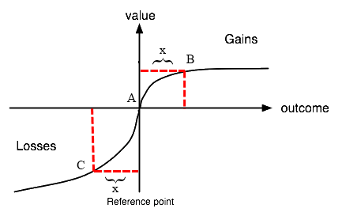
Theoretical Explanation of Endowment Effect using Cognitive Biases
Psychological Inertia (proposed by David Gal)
Neoclassical Theories (Hanemann, 1991)
Loss Aversion and Reference-Dependence, related to Prospect Theory (Daniel Kahneman et. al.)

Slide 14
Implications in the Real World
Endowment Effect may postulate that individual consumers have no indifference curves (Hovenkamp, 1991), rendering neoclassical tools of welfare analysis useless, and thus legal courts must use WTA as a measure of value.
Endowment Effect is also a possible explanation for lack of demand for reverse mortgage opportunities in the United States (Huck et. al. 2005).

Slide 15
Conclusion
Daniel Kahneman’s contribution to behavioral economics has shaped the way policy-makers draft welfare, growth, and development policies, how companies market their products, and in several other ways organizations and individuals make their crucial decisions.
His work on cognitive biases is worth studying even by non-psychologists and non-economists, and has helped us understand how the human mind works.

Slide 16
THANK YOU!

